Slide 1




A piece of Caching, please!
David Rodriguez
Microsoft Azure MVP / Insider / Advisor
DNN Cloud Team Lead Engineer
@davidjrh

Slide 2
My
“Mobile First, Cloud First.” app
DavidNews DEMO
https://github.com/davidjrh/davidnews

Slide 3
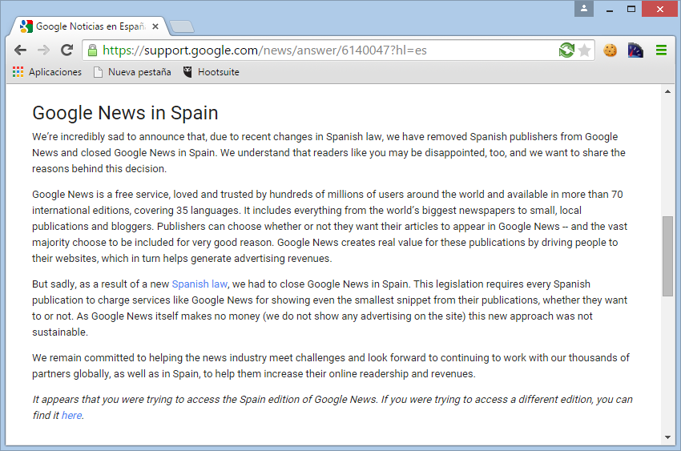
http://news.google.es

Slide 4



Architecture
BUSINESS LOGIC
CLOUD
SERVICE
WEBSITES
MOBILE
SERVICE
STORAGE
CACHE
https://github.com/davidjrh/davidnews

Slide 5
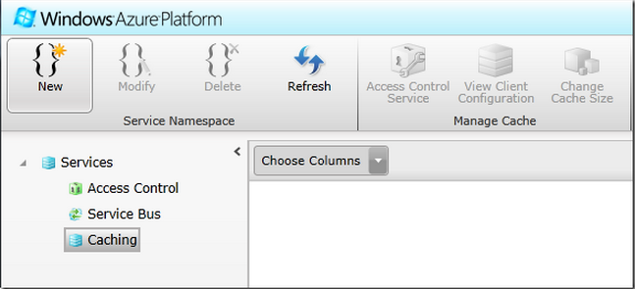
Caching options on Azure?
Shared Caching | In Role | Managed Cache | Redis Cache
Retired on Sep 1st, 2014 | Generally Available | Generally Available | Generally Available (Oct 7th 2014)
Provisioned through the “Silverlight” portal | Provisioned via PowerShell/Azure SDK | Provisioned via PowerShell | Provisioned via PowerShell/Ibiza/REST
 | Based on AppFabric Cache | Based on AppFabric Cache | Based on Redis (more than cache)
 | Collocated or dedicated | Dedicated | Dedicated (HA available)
 | Managed by YOU | Managed by MS | Managed by MS
 | Ideal for Cloud Services | Ideal for Websites, Cloud Svcs, VMs… | Ideal for all the services
 | Use of local memory recommended | Use of local memory recommended | Super performance
Notes:
How to create InRole via PowerShell
Add-AzureCacheWorkerRole
How to create Redis via PowerShell
You could try updating your PowerShell Module to one released on or after October 4.
You could use the following link:
https://github.com/Azure/azure-sdk-tools/releases
Switch to Azure Resource Manager Mode (Switch-AzureMode AzureResourceManager) and you could try the following cmdlets:
New-AzureRedisCache
Get-AzureRedisCache
Set-AzureRedisCache
Remove-AzureRedisCache
New-AzureRedisCacheKey
Get-AzureRedisCacheKey

Slide 6
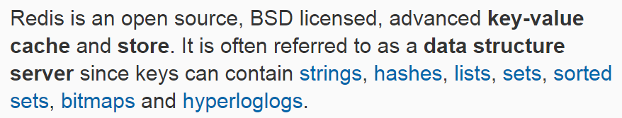
What is Redis?
Key-value store (REmote DIctionary Server)
Transactional
Persistent
Highly available (Master/slave and clustering)
Publisher/subscriber without polling

Slide 7
What is Redis?
Batched commands
Scripting Support (LUA)
Mass insertions
On-premises Support
Support for +30 programming languages
High performance

Slide 8
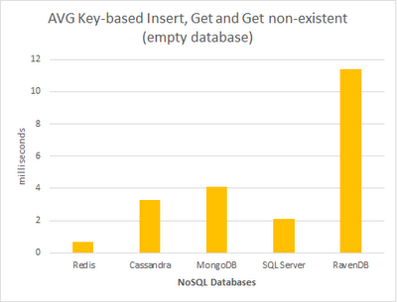
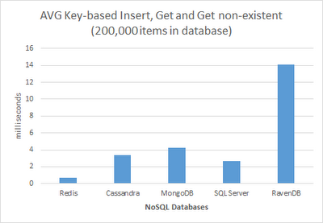


NoSQL Benchmarking
Source: http://byterot.blogspot.com.es/2012/11/nosql-benchmark-redis-mongodb-ravendb-cassandra-sqlserver.html

Slide 9









Who’s using Redis?
Source: http://redis.io/topics/whos-using-redis

Slide 10
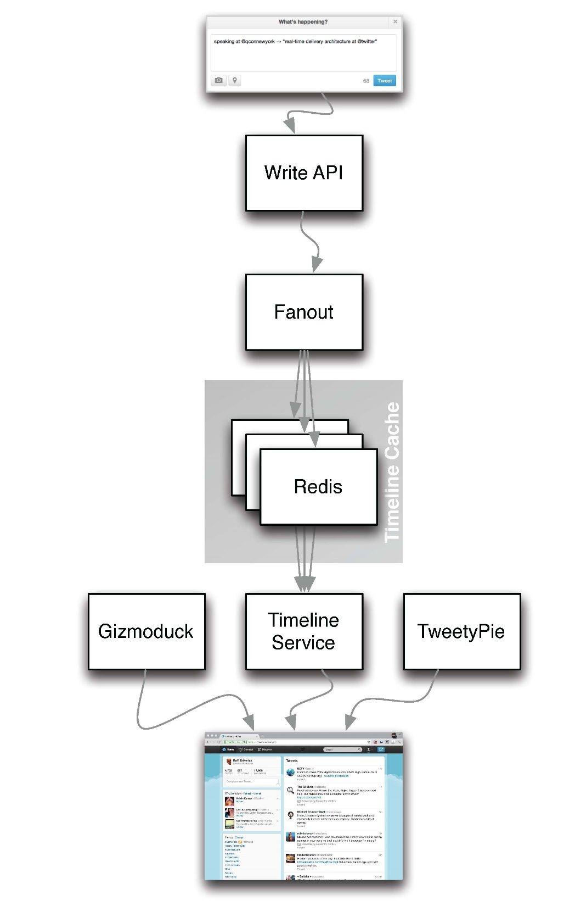

Twitter implementation
30 billion timeline updates/day
5000 tweets/sec
400 million tweets/day
“Just one of my tweets updates Redis 65 million times”
@katyperry
Notes:
More info:
http://blog.pivotal.io/pivotal/case-studies-2/case-study-staple-yourself-to-a-tweet-to-understand-30-billion-redis-updates-per-day
http://www.infoq.com/presentations/Twitter-Timeline-Scalability

Slide 11





Slide 12
Some Numbers
A cluster can grow around to ~1000 master nodes
1 million small “key -> string” ~100MB RAM
A normal Linux deployment supports ~500k req/sec
Storage limit === available RAM
Máx. 2³² keys

Slide 13

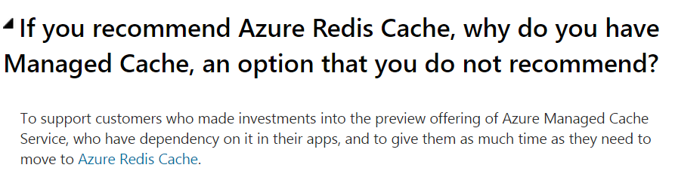
Redis is the recommended
https://msdn.microsoft.com/en-us/library/azure/dn766201.aspx
https://msdn.microsoft.com/en-us/library/azure/dn386094.aspx

Slide 14
No doubt, use Redis.

Slide 15
Redis Provisioning
DEMO

Slide 16
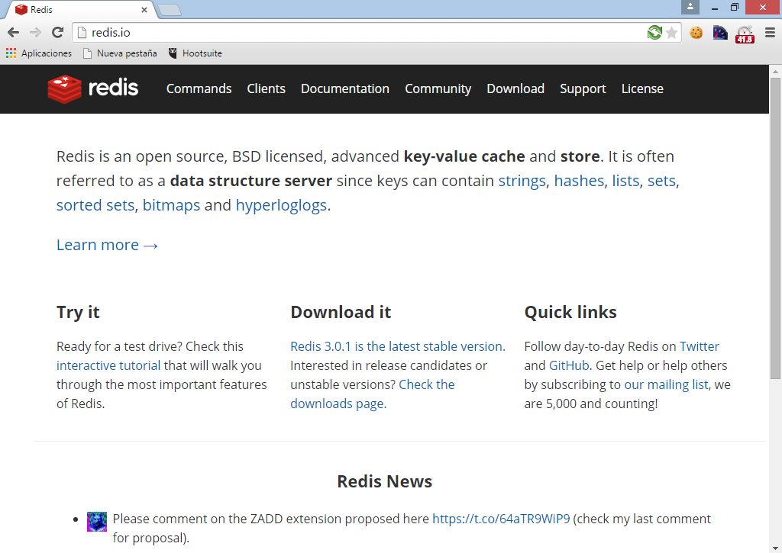

Slide 17
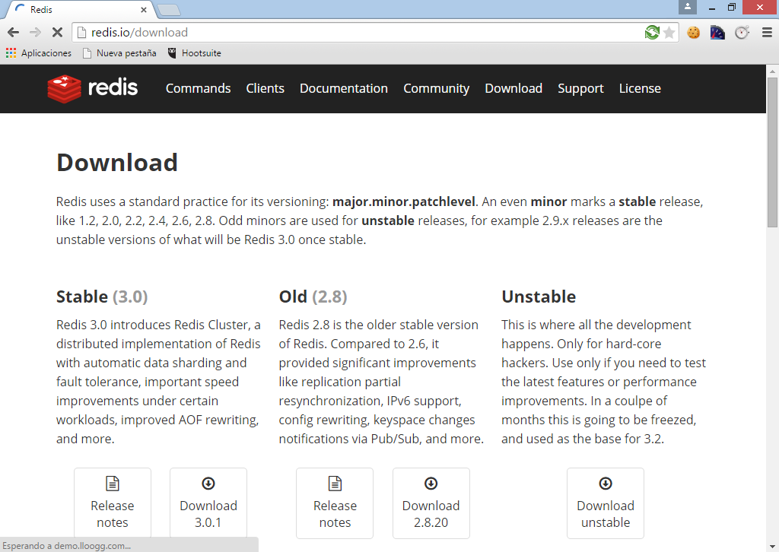

Slide 18
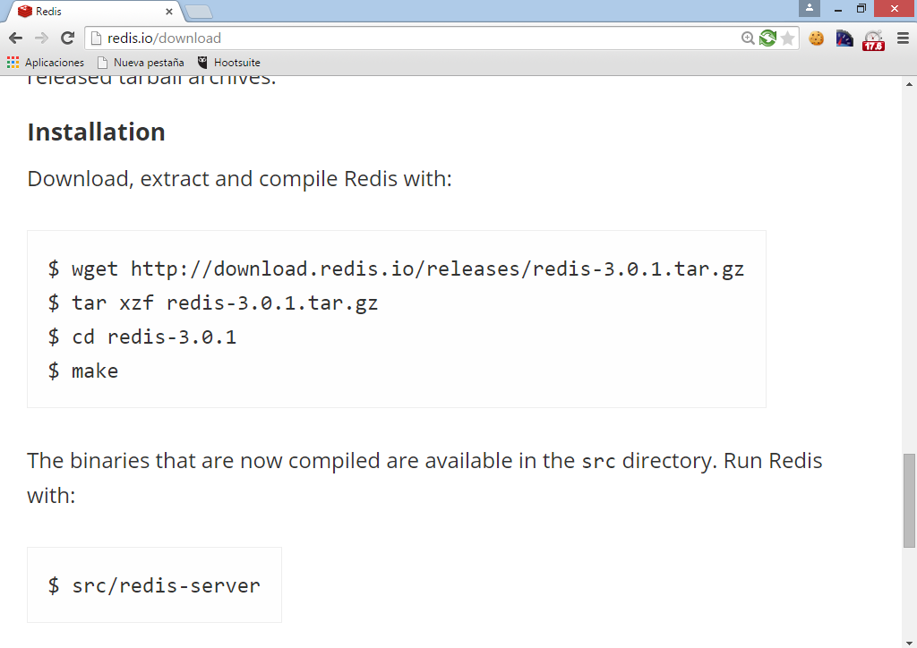

Slide 19
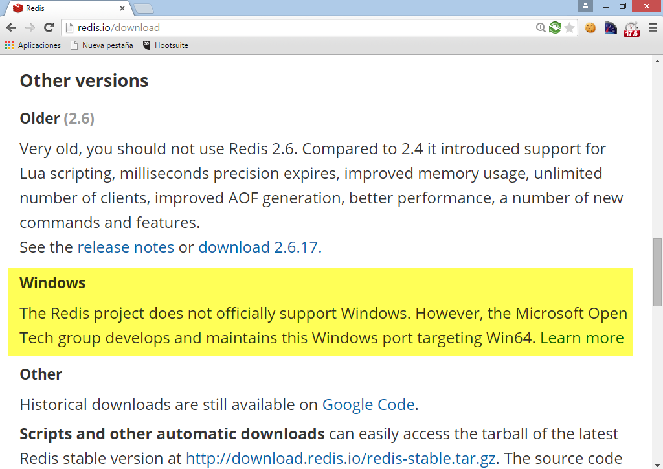

Slide 20
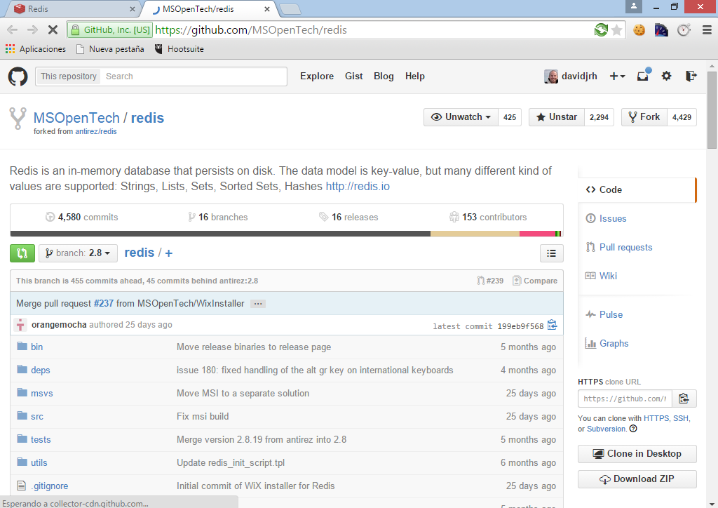

Slide 21
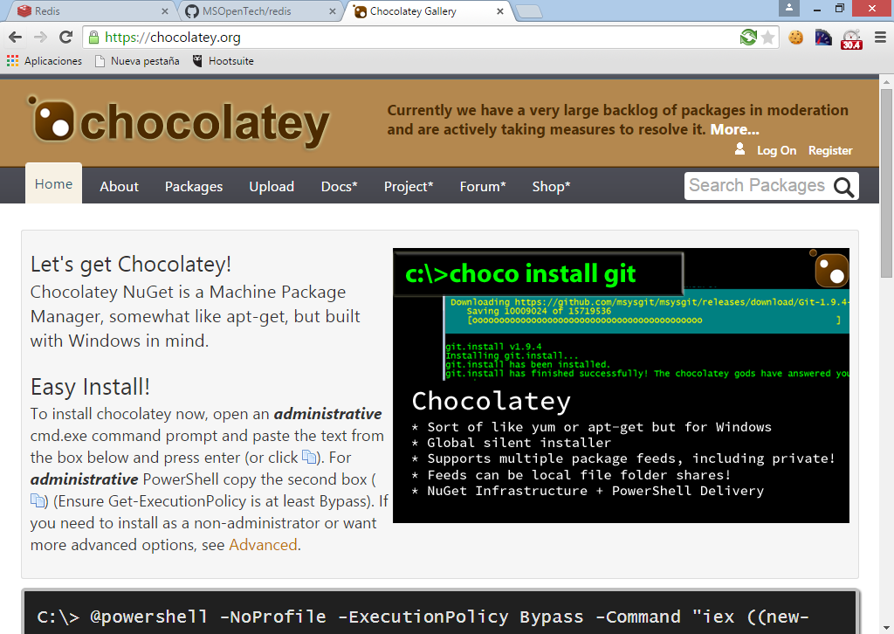

Slide 22
Installing Redis on Windows
C:\> choco install redis-64

Slide 23
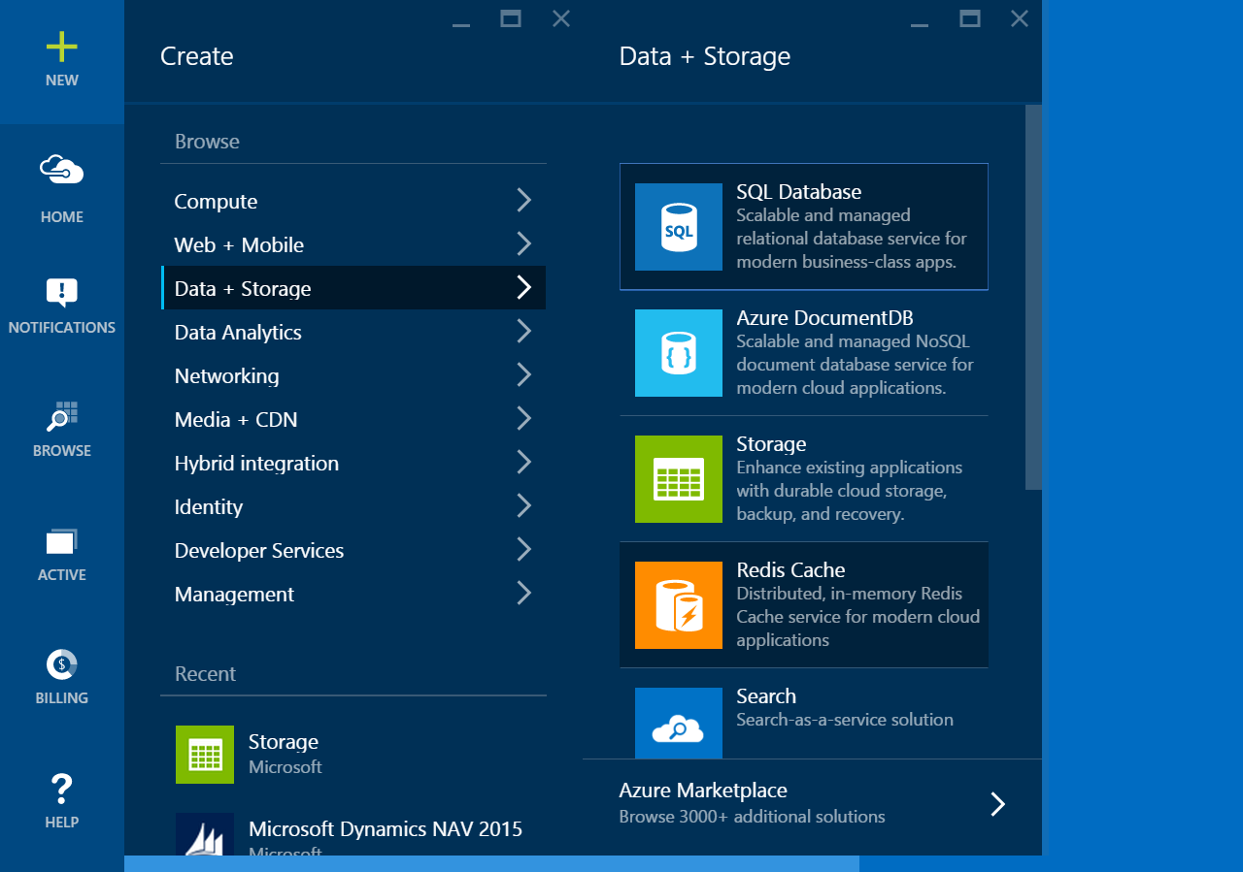

Slide 24
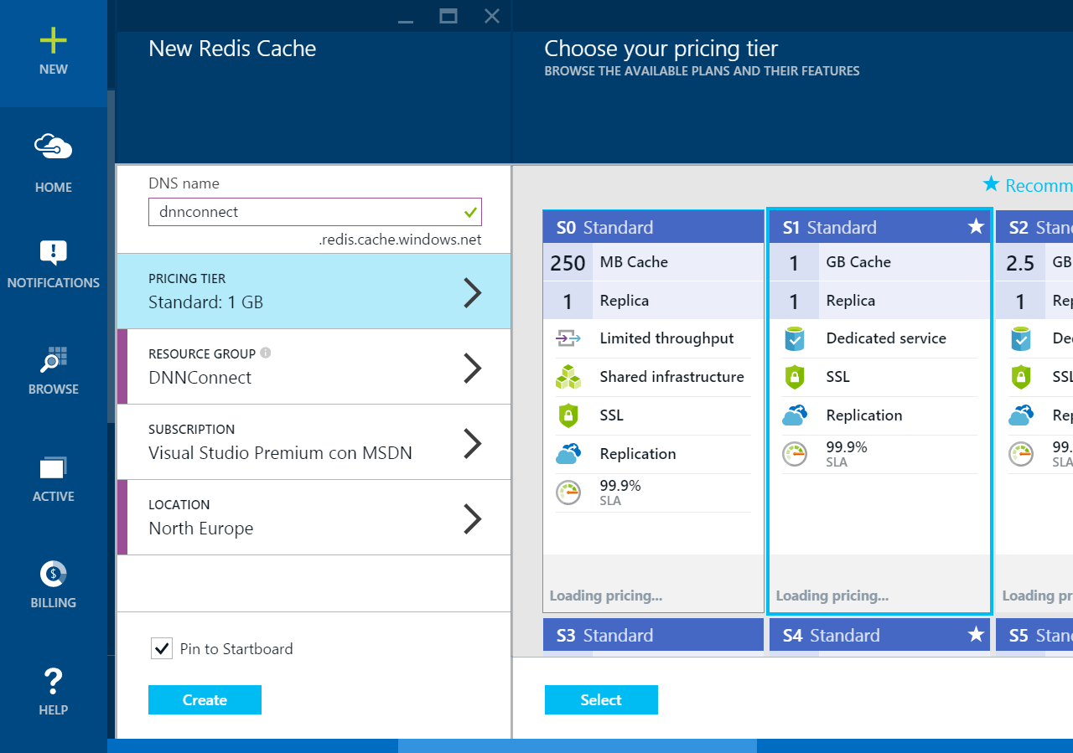

Slide 25
Redis and .NET

Slide 26
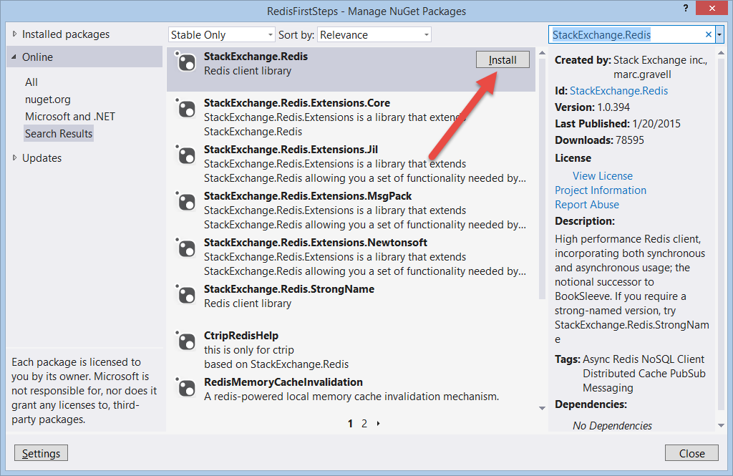
Using Redis from .NET
Nuget: StackExchange.Redis
https://github.com/StackExchange/StackExchange.Redis

Slide 27
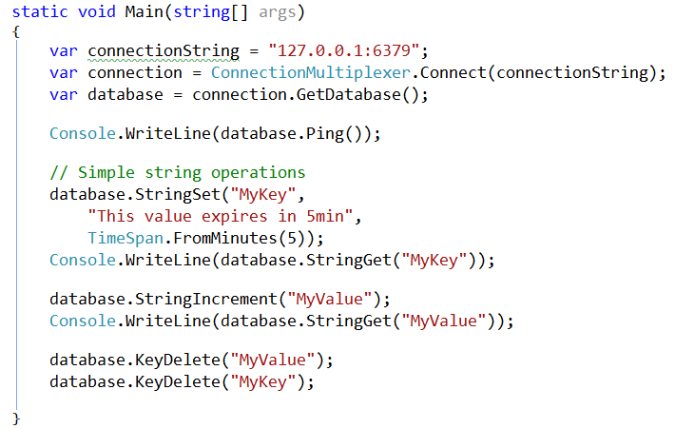
Simple operations

Slide 28
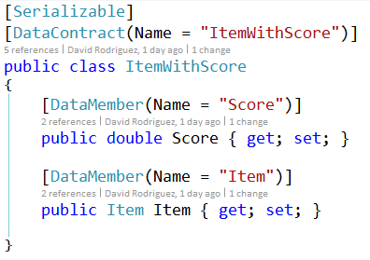
Distributed caching paradigm
Serialize objects before storing
Objects must be “Serializable”
“Item” class must be
serializable as well

Slide 29
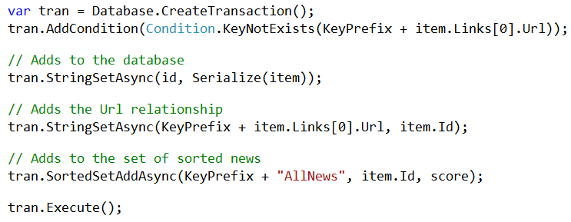
Transactions

Slide 30
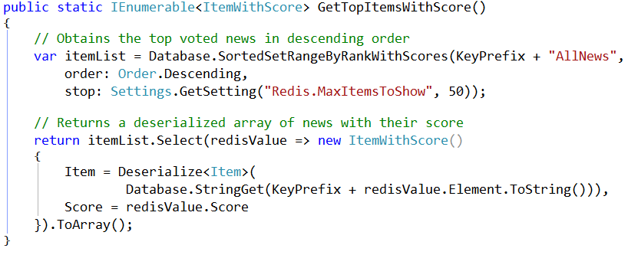
Complex operations

Slide 31

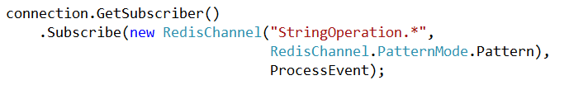
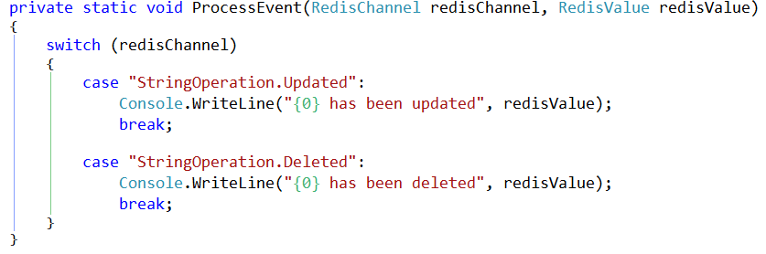
Publisher / Subscriber

Slide 32
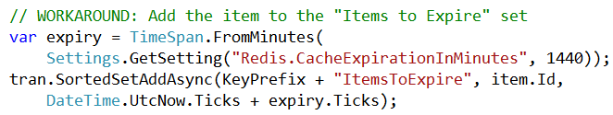
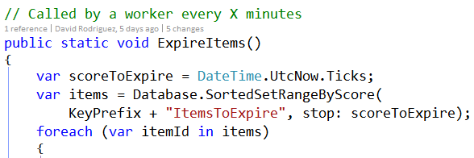
No expiration callback support

Slide 33
Scaling, Sharding and beyond
Spread reads over the slaves
Problem: hard limit caused by max RAM available
Solution: sharding
  Welcome Redis 3.0: clustering!
Notes:
http://www.pivotal.io/big-data/case-study/leading-video-company-scales-to-serve-4-billion-videos-with-800-percent-query-performance-improvement-hulu

Slide 34


Redis scales…verified!

Slide 35
Digging into DavidNews source code
DEMO
https://github.com/davidjrh/davidnews

Slide 36
Redis and DNN

Slide 37
Hybrid implementations
Store cached objects in memory and Redis
GetItem(key)
        Checks local memory first
        Gets from Redis. If success, copy into local memory
Use Publisher/Subscriber model to sync local memory on other subscribers
IN-MEMORY CACHE
REDIS CACHE

Slide 38

Scaling Azure Websites
How to share the cache?
How to sync in memory cache?
REDIS CACHE
IN-MEMORY CACHE
Publisher / Subscriber

Slide 39
Redis caching provider for DNN Platform
DEMO
https://github.com/davidjrh/dnn.rediscachingprovider

Slide 40
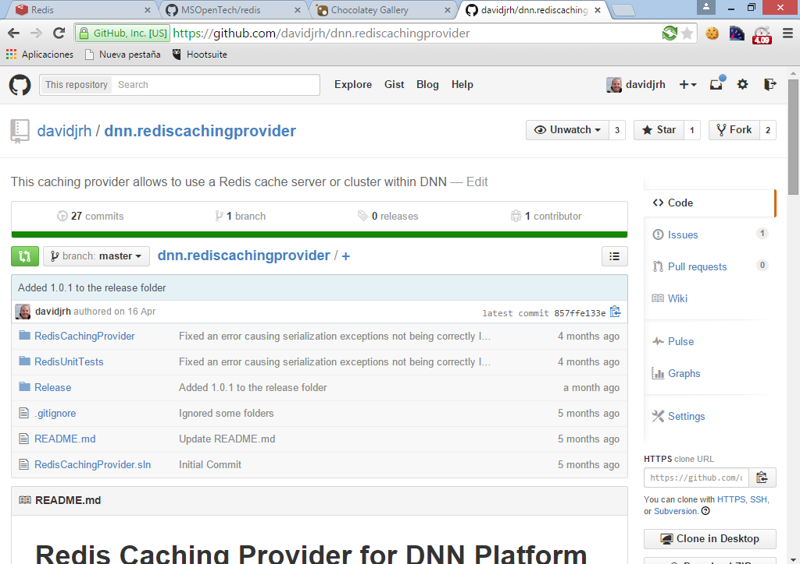

Slide 41
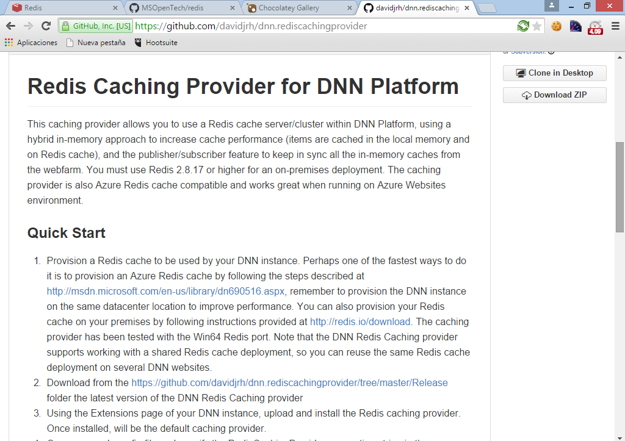

Slide 42
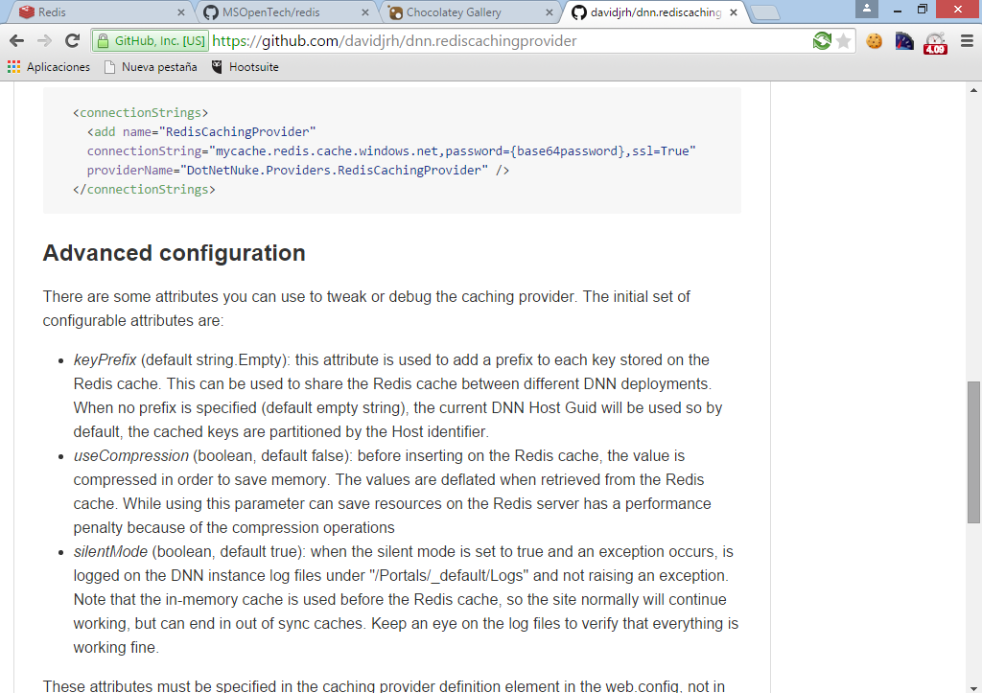

Slide 43
Storing session data on Redis
DEMO

Slide 44
Key takeaways
Redis is the Microsoft recommended service for caching
High performance, available and interoperable
For on-premises or for the cloud, same solution, no lock-ins

Slide 45
Questions?
@davidjrh

Slide 46










X
Y
B
A
David Rodriguez
Microsoft Azure MVP / Insider / Advisor
DNN Cloud Team Lead Engineer
@davidjrh

